Slide 1
Lecture 10 : Concurrency Control

Slide 2
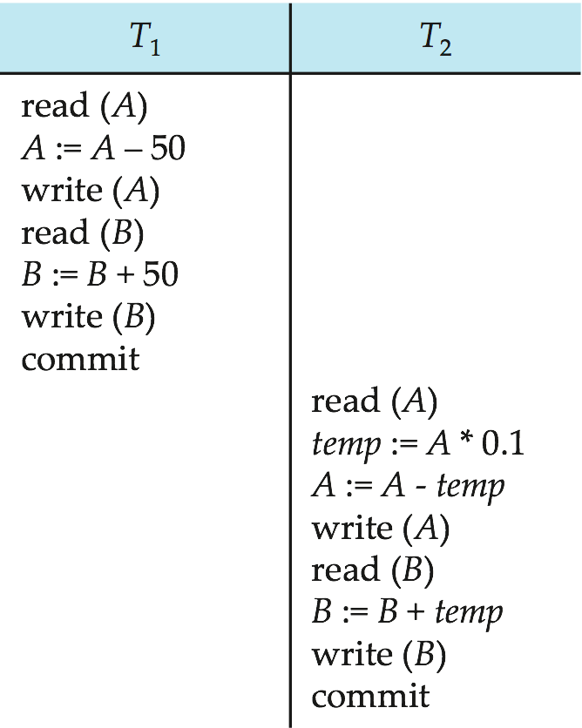
Example 1: Schedule 1
A serial schedule in which T₁ is followed by T₂ :
1000
950
950
2000
2050
2050
950
95
855
855 (A)
2050
2145
2145 (B)
Total A+B= 3000

Slide 3
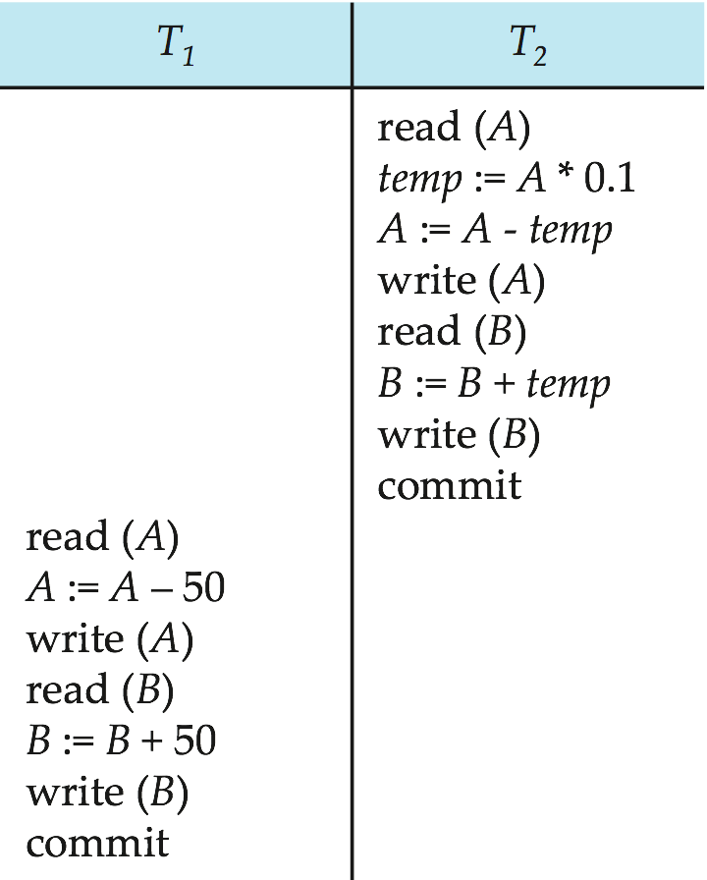
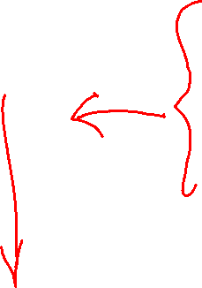
Example 1: Schedule 2
A serial schedule where T₂ is followed by T₁
1000
100
900
900
2000
2100
2100
900
850
850
2100
2150
2150
Total A+ B = 850 + 2150 = 3000

Slide 4
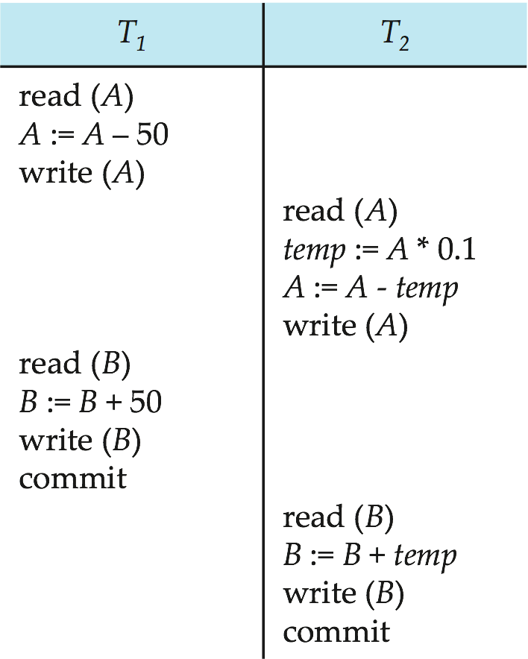
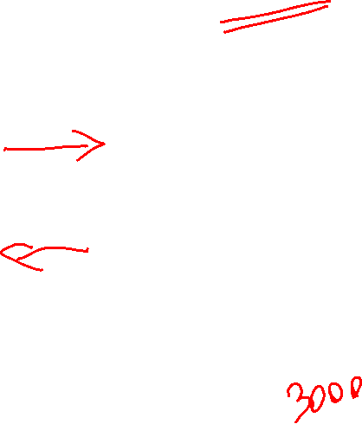
Example 1: Schedule 3
Let T₁ and T₂ be the transactions defined previously. The following schedule is not a serial schedule, but it is equivalent to Schedule 1.
In Schedules 1, 2 and 3, the sum A + B is preserved.

Slide 5
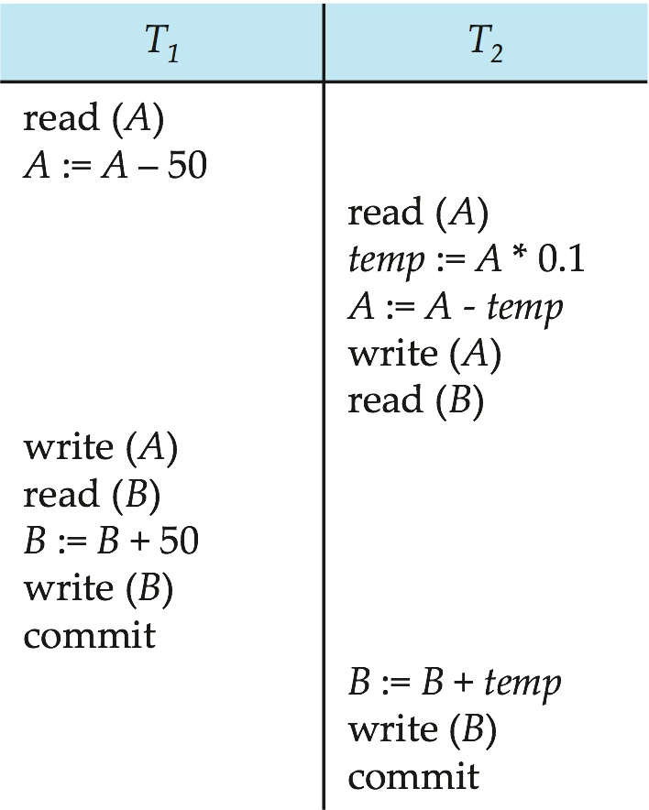
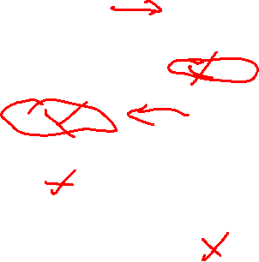
Example 1: Schedule 4
The following concurrent schedule does not preserve the value of (A + B ). Assign values and see why?
1000
950
A=950
2000
2050
2050
B=2050
1000
100
900
A=900
2000
2100
B=2100

Slide 6
Schedules
Schedule – a sequence of instructions that specify the chronological order in which instructions of concurrent transactions are executed
Serial schedules have less resource utilization and low throughput. To improve it, two are more transactions are run concurrently.
But concurrency of transactions may lead to inconsistency in database (Schedule4)
To avoid this, we need to check whether these concurrent schedules are serializable or not.
What is Serializability?

Slide 7

Serializability
Basic Assumption – Each transaction preserves database consistency. E.g. Sum of A + B is preserved in earlier Schedules
Serializability is considered the highest level of isolation between transactions
Serial execution of a set of transactions preserves database consistency.
A (possibly concurrent) schedule is serializable if it is equivalent to a serial schedule (E.g. Schedule 3)
Different forms of schedule equivalence give rise to the notions of:
1. conflict serializability
2. view serializability

Slide 8
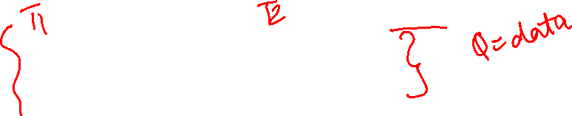
Conflicting Instructions
Instructions l_{i} and l_{j} of transactions T_{i} and T_{j} respectively, conflict if and only if there exists some item Q accessed by both l_{i} and l_{j}, and at least one of these instructions performs write of Q.
1. l_{i} = read(Q), l_{j} = read(Q). l_{i} and l_{j} don’t conflict. 2. l_{i} = read(Q), l_{j} = write(Q). They conflict. 3. l_{i} = write(Q), l_{j} = read(Q). They conflict 4. l_{i} = write(Q), l_{j} = write(Q). They conflict
Intuitively, a conflict between l_{i} and l_{j} forces a (logical) temporal order between them.
If l_{i} and l_{j} are consecutive in a schedule and they do not conflict, their results would remain the same even if they had been interchanged in the schedule.

Slide 9
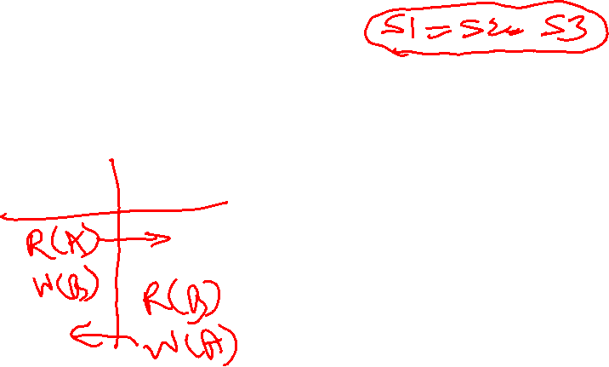
Conflict Serializability
If a schedule S can be transformed into a schedule S´ by a series of swaps of non-conflicting instructions, we say that S and S´ are conflict equivalent.
We say that a schedule S is conflict serializable if it is conflict equivalent to a serial schedule

Slide 10
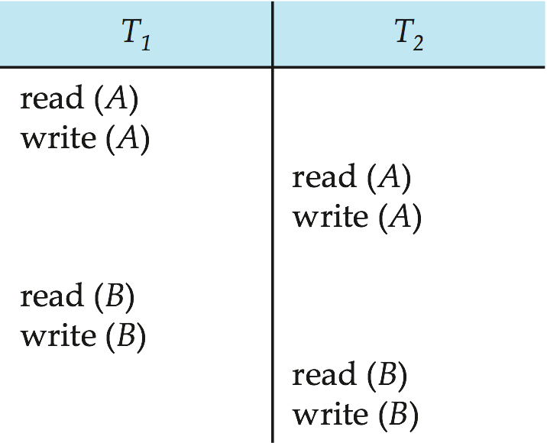
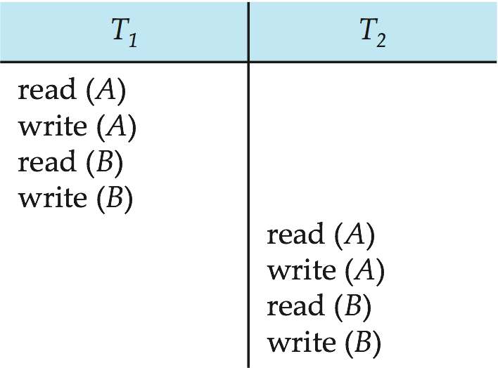
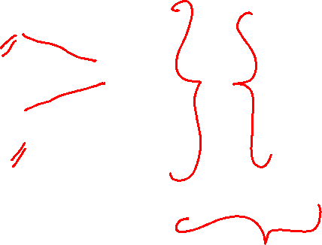
Conflict Serializability (continued)
Schedule 3 can be transformed into Schedule 6, a serial schedule where T₂ follows T₁, by series of swaps of non-conflicting instructions. Therefore Schedule 3 is conflict serializable.
Conflict
No Conflict
Conflict
Schedule 3
Schedule 6

Slide 11
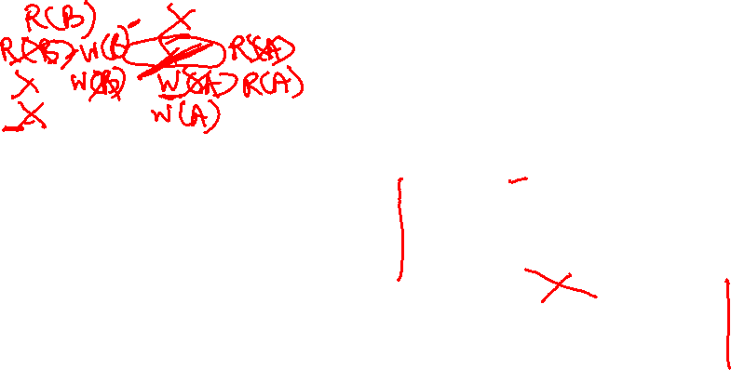
Conflict Serializability (continued)
T1 | T2
read(A)
write(A)
 | read(A)
 | write(A)
read(B)
write(B)
 | read(B)
 | write(B)
Write(A) of T2 does not conflict with read(B) of T1, swap their sequence
Swap read(B) of T1 with read(A) of T2
Swap write(B) of T1 with write(A) of T2
Swap write(B) of T1 with read(A) of T2

Slide 12
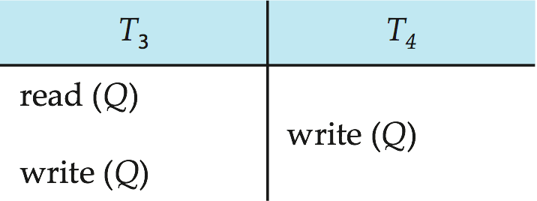
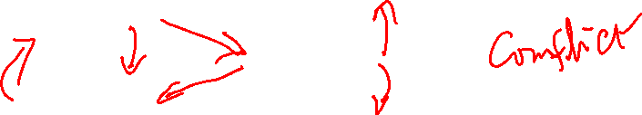
Conflict Serializability (continued)
Example of a schedule that is not conflict serializable:
We are unable to swap instructions in the above schedule to obtain either the serial schedule < T₃, T₄ >, or the serial schedule < T₄, T₃ >.

Slide 13
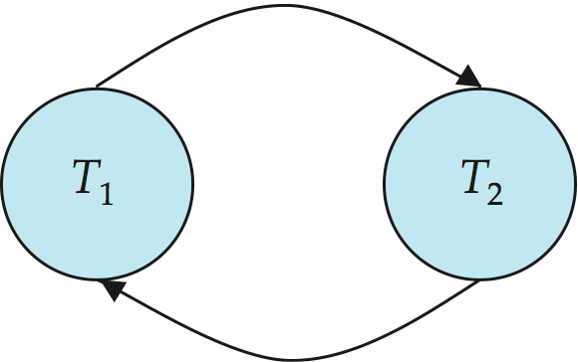
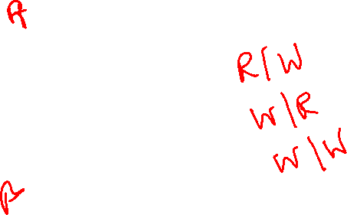
Testing for Serializability
Consider some schedule of a set of transactions T₁, T₂, ..., T_{n}
Precedence graph — a directed graph where the vertices are the transactions (names).
We draw an arc from T_{i} to T_{j} if the two transactions conflict, and T_{i} accessed the data item on which the conflict arose earlier.
We may label the arc by the item that was accessed.
Example 1

Slide 14
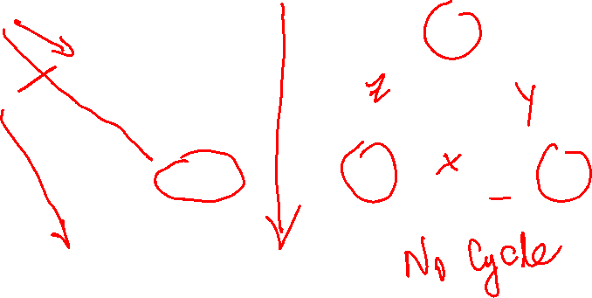
Testing for Serializability
A schedule is conflict serializable if its precedence graph is not cyclic.
T2
T1
T3

Slide 15
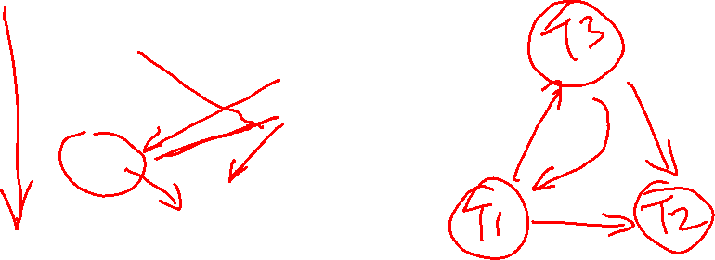
Class Exercise 1
Create a precedence graph

Slide 16

Class Exercise 1 - Answer
T3
T1
T2
Precedence graph for this schedule is cyclic, so it is NOT conflict serializable

Slide 17
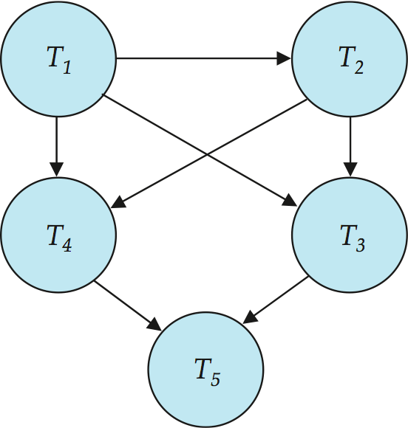
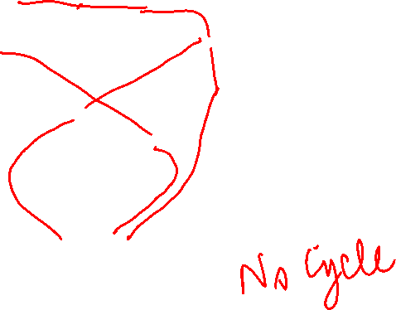
Is this a conflict serializable schedule?

Slide 18
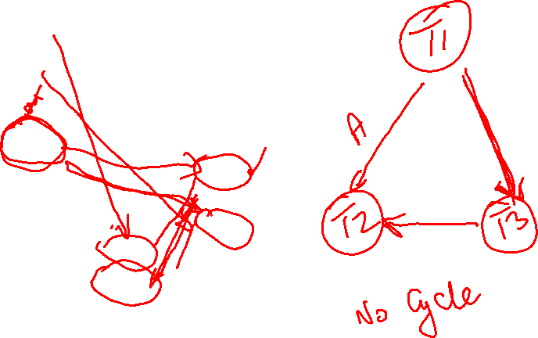
Class Exercise 2
Create a precedence graph
T1 | T2 | T3
R(A)
R(B)
 | R(A)
 | R (C)
W(B)
 |  | R (B)
 |  | R (C)
 |  | W(B)
 | W(A)
 | W (C)

Slide 19
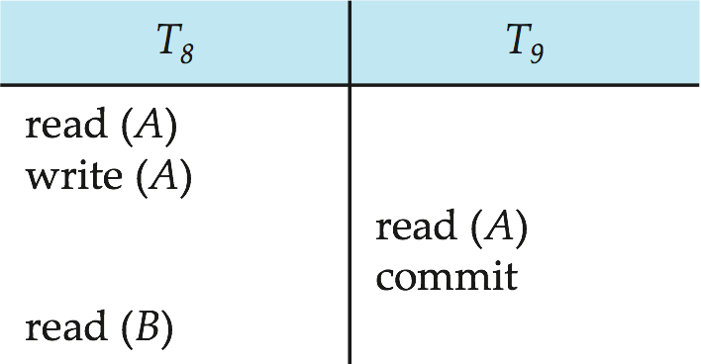

Recoverable Schedules
Need to address the effect of transaction failures on concurrently running transactions.
Recoverable schedule — if a transaction T_{j} reads a data item previously written by a transaction T_{i} , then the commit operation of T_{i} should appear before the commit operation of T_{j}.
The following schedule is not recoverable if T₉ commits immediately after the read
If T₈ should abort, T₉ would have read (and possibly shown to the user) an inconsistent database state.
Database must ensure that schedules are recoverable.

Slide 20
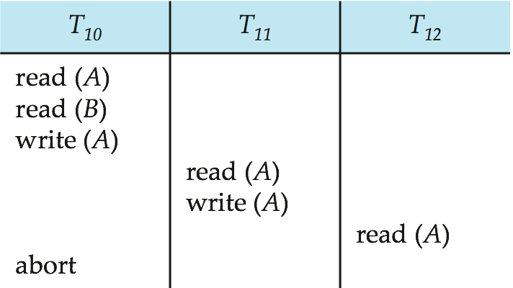
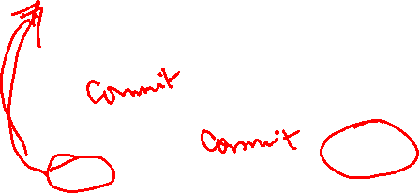
Cascading Rollbacks
Cascading rollback – a single transaction failure leads to a series of transaction rollbacks. Consider the following schedule where none of the transactions has yet committed (so the schedule is recoverable) If T₁₀ fails, T₁₁ and T₁₂ must also be rolled back.
Can lead to the undoing of a significant amount of work

Slide 21
Cascadeless Schedules
Cascadeless schedules — cascading rollbacks cannot occur if for each pair of transactions T_{i} and T_{j} such that T_{j} reads a data item previously written by T_{i}, the commit operation of T_{i} appears before the read operation of T_{j}
Every cascadeless schedule is also recoverable
It is desirable to restrict the schedules to those that are cascadeless

Slide 22
Concurrency Control
A database must provide a mechanism that will ensure that all possible schedules are
conflict serializable, and
are recoverable and preferably cascadeless
A policy in which only one transaction can execute at a time generates serial schedules, but provides a poor degree of concurrency
E.g. Airline seat selection
Testing a schedule for serializability after it has executed is a little too late!
Goal – to develop concurrency control protocols that will assure serializability.
How do we achieve these results?
Allow only one set of transactions to run at a time?
What will happen if entire database runs only these transactions?

Slide 23
Locking-based Concurrency Control
Locks:
Transaction level locks
Guarantee exclusive use of a data item to a current transaction
T2 does not have access to a data item that is currently being locked by T1
T1 acquires a lock on an item prior to data access
The lock is released after the transaction is completed:
Other transactions can then lock the item
Other mechanisms to achieve concurrency control:
Timestamps
Multiple versions/ Snapshots
Predicate locking (based on where condition)

Slide 24

Locking Algorithms
Lock manager:
A module that is responsible for assigning the locks to transactions
Lock types:
Binary locks:
An item can be in one of two states:
LOCKED
UNLOCKED
Shared/Exclusive locks:
An item can be in one of three states:
UNLOCKED
SHARED lock by more than one transaction – denoted by S
EXCLUSIVE lock by only one transaction – denoted by X

Slide 25
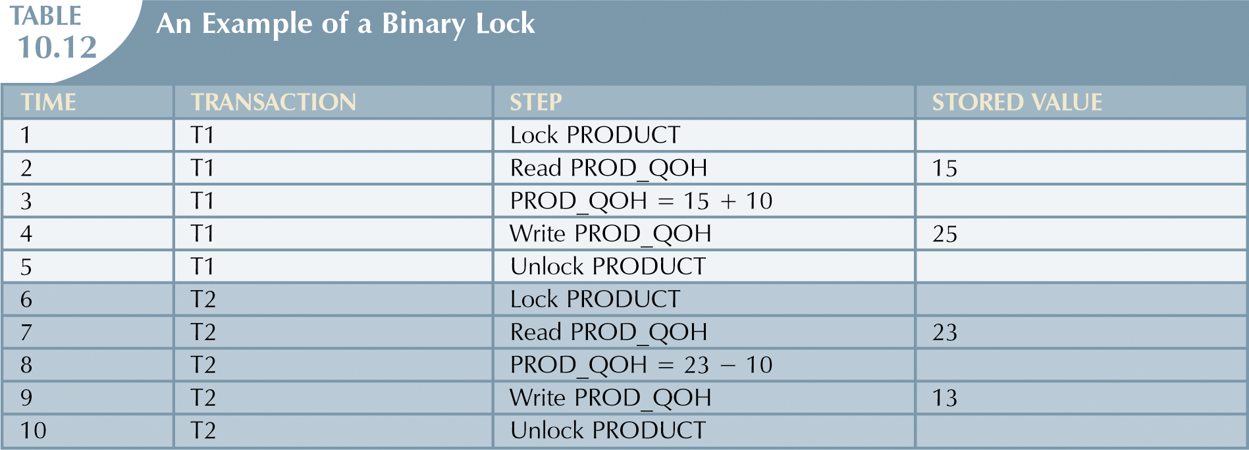

Solves the Lost update problem

Slide 26
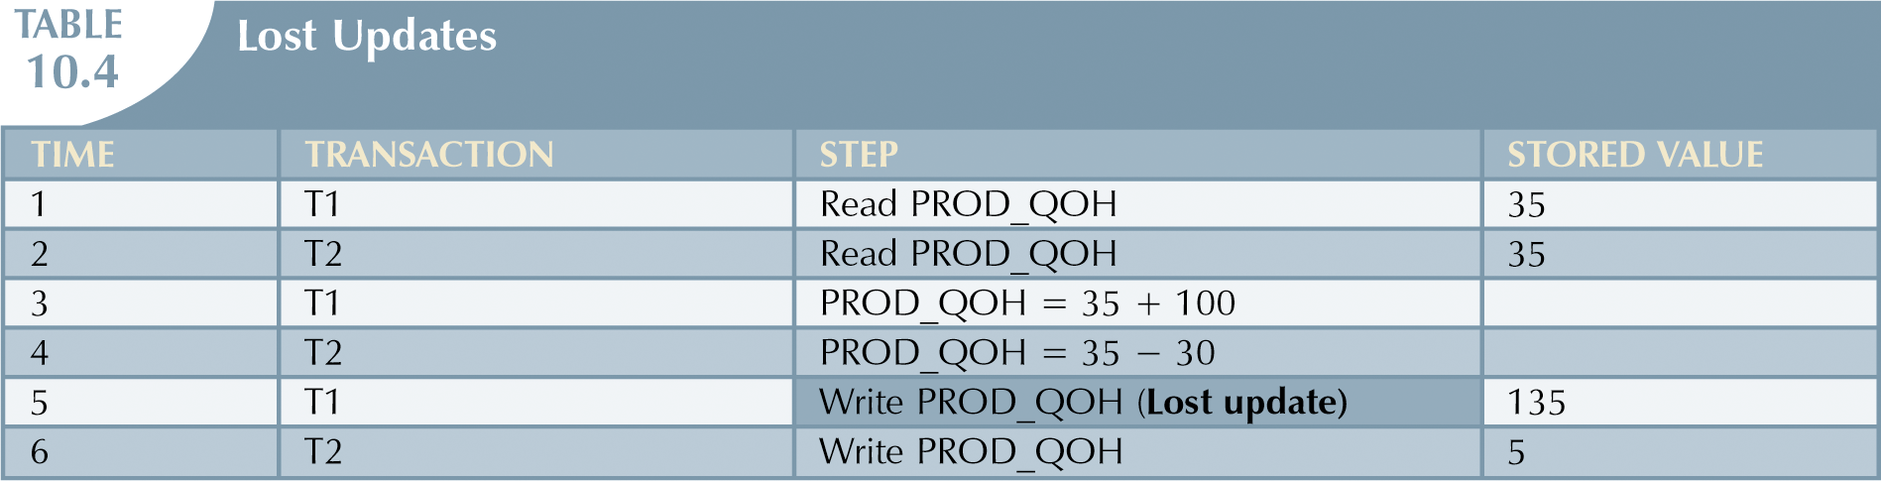

Lost Update Problem
T1: R(Q) W(Q) C
T2: R(Q) W(Q)C
Lost Update of T1

Slide 27
Binary Locks (continued)
Binary lock is too restrictive
T1 does not need to lock an object if it only reads
Two operations conflict only if one of them is WRITE

Slide 28
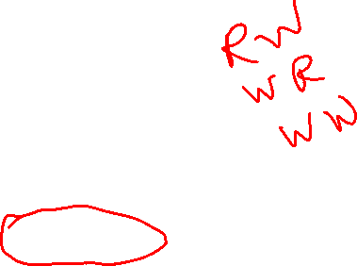
Shared/Exclusive Locks
A lock can be in three states:
Unlocked, shared, or exclusive
Exclusive mode (X):
Access is reserved only for the transaction that locked the object
When there is a potential conflict
Granted if:
Operation is WRITE
The object does not hold any other locks
Shared mode (S):
When concurrent transactions only read the object
Granted if:
Operation is READ
The object does not hold any exclusive locks

Slide 29
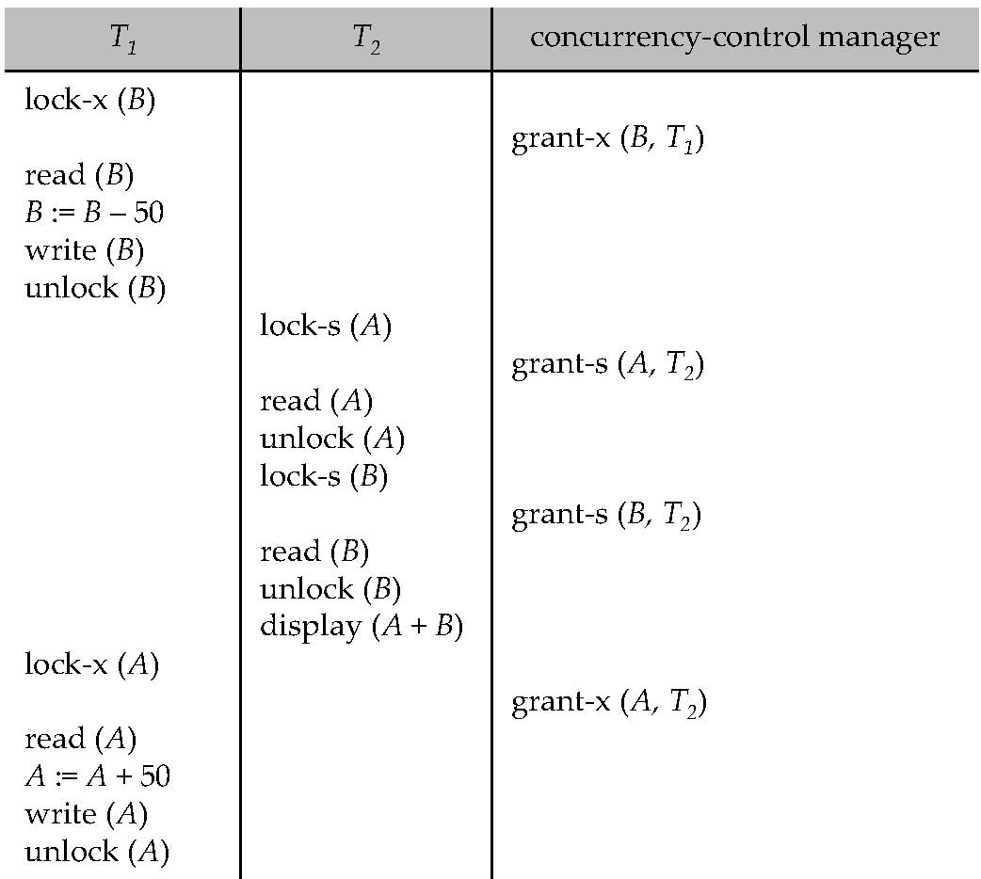
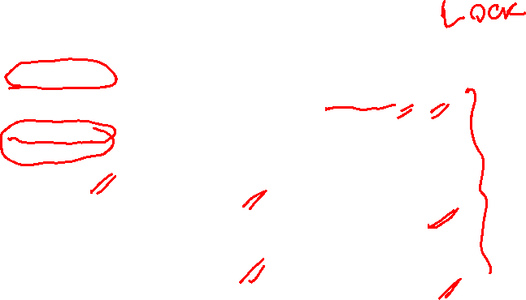
Example of S/X locks
Misprint – this is T1

Slide 30
Mutually Exclusive Rule
Only one transaction at a time can own an exclusive lock on the same object

Slide 31
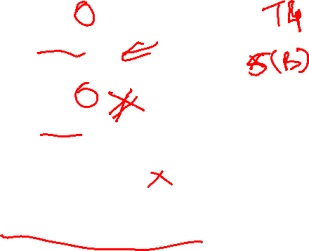
Lock-Based Protocols
Example of a transaction performing locking:
T₂: lock-S(A);
read (A);
unlock(A);
lock-S(B);
read (B);
unlock(B);
display(A+B)
Locking as above is not sufficient to guarantee serializability — if A and B get updated in-between the read of A and B, the displayed sum would be wrong.
A locking protocol is a set of rules followed by all transactions while requesting and releasing locks. Locking protocols restrict the set of possible schedules.

Slide 32

Lock-Based Protocols (continued)
Lock-compatibility matrix
A transaction may be granted a lock on an item if the requested lock is compatible with locks already held on the item by other transactions
Any number of transactions can hold shared locks on an item,
but if any transaction holds an exclusive on the item no other transaction may hold any lock on the item.
If a lock cannot be granted, the requesting transaction is made to wait till all incompatible locks held by other transactions have been released. The lock is then granted.

Slide 33
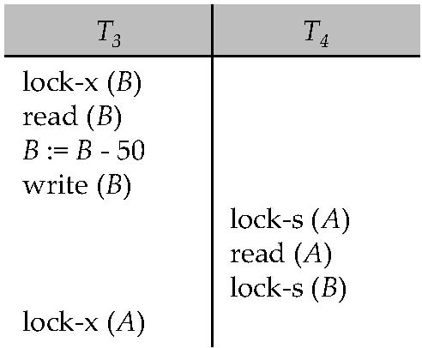
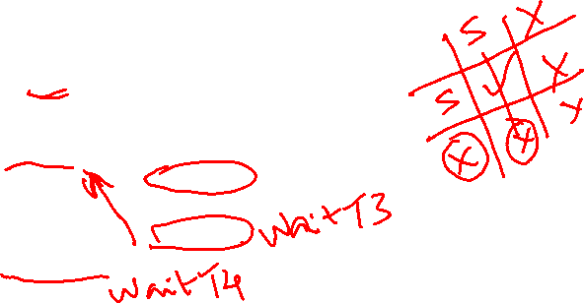
Pitfalls of Lock-Based Protocols: Deadlock
Consider the partial schedule
Neither T₃ nor T₄ can make progress — executing lock-S(B) causes T₄ to wait for T₃ to release its lock on B, while executing lock-X(A) causes T₃ to wait for T₄ to release its lock on A.
Such a situation is called a deadlock.
To handle a deadlock one of T₃ or T₄ must be rolled back and its locks released.

Slide 34
Pitfalls of Lock-Based Protocols: Starvation
Starvation is also possible if concurrency control manager is badly designed. For example:
A transaction may be waiting for an X-lock on an item, while a sequence of other transactions request and are granted an S-lock on the same item.
The same transaction is repeatedly rolled back due to deadlocks.
Concurrency control manager can be designed to prevent starvation as follows:
A lock is provided for an item Q if
there are no other transactions that are waiting for a lock on Q, whether eXclusive or Shared

Slide 35
Two-phase locking
An algorithm to define how transactions can acquire and release locks
Guarantee serializability
Two phases:
A growing phase
A shrinking phase

Slide 36
Two-phase locking (continued)
Growing phase:
A transaction acquires all required lock(s) without unlocking any data
The transaction is in its locked point:
When all locks have been acquired
Shrinking phase:
A transaction releases all locks
Cannot obtain any new locks

Slide 37
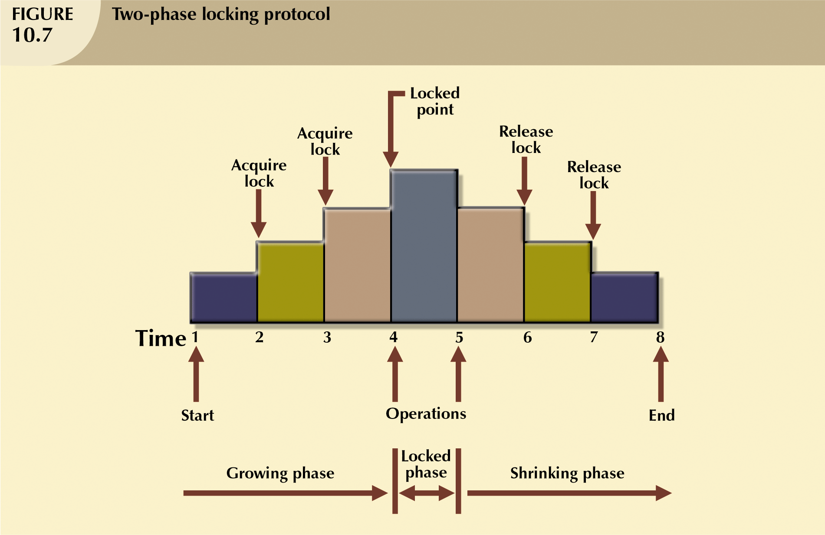
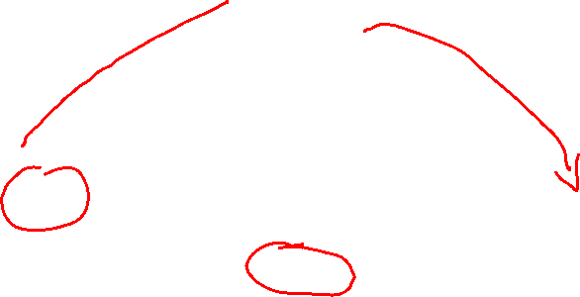

Slide 38
This schedule does not follow 2PL
T2 unlocked A early so that T1 can see inconsistent data

Slide 39
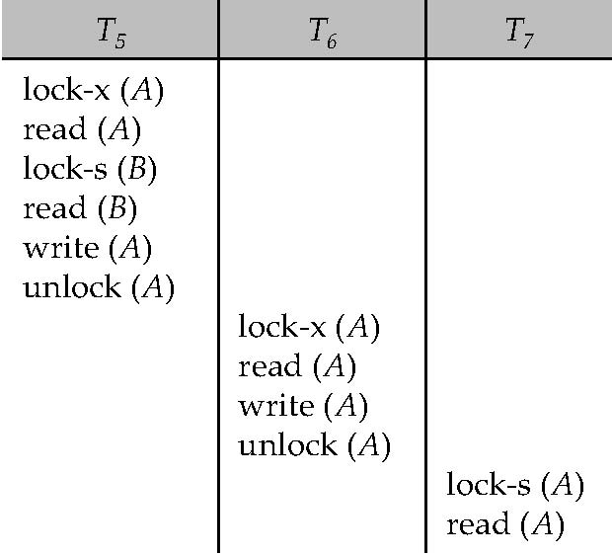
Can 2PL cause cascading roll back?
Failure of T₅ after Read(A) step of T₇ leads to cascading rollback of T₆ and T₇

Slide 40

The Two-Phase Locking Protocol (continued)
Two-phase locking does not ensure freedom from deadlocks
Cascading roll-back is possible under two-phase locking. To avoid this, follow a modified protocol called strict two-phase locking. Here a transaction must hold all its exclusive locks till it commits/aborts.

Slide 41
Deadlocks
When two transactions wait indefinitely for each other to unlock data
Example:
T1 ➔ accesses X and Y
T2 ➔ accesses Y and X
T1 locked X
T2 locked Y
T1 is waiting to lock Y in order to finish
T2 is waiting to lock X in order to finish
T1 and T2 each is waiting to the other one to unlock an item

Slide 42
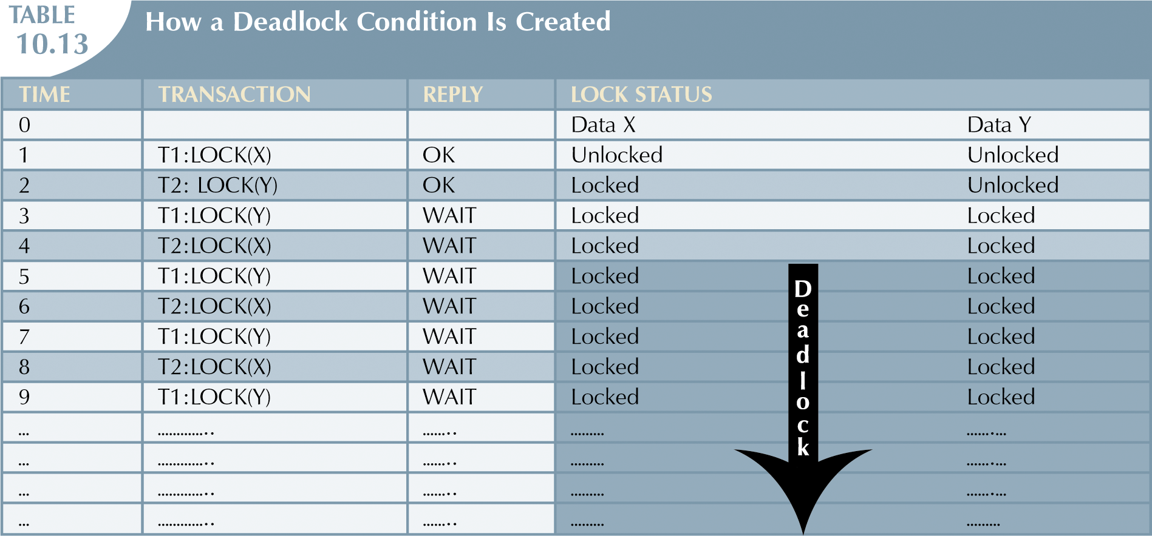


Slide 43
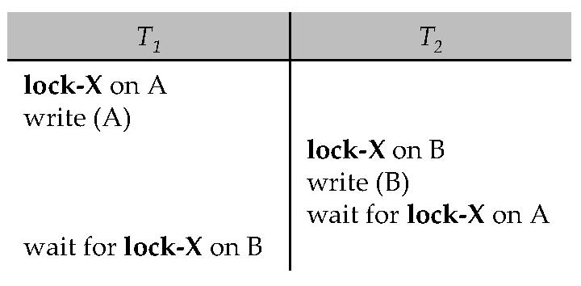

Deadlock Handling
Consider the following two transactions:
T₁: write (X) T₂: write(Y)
write(Y) write(X)
Schedule with deadlock

Slide 44
Deadlock Handling
System is deadlocked if there is a set of transactions such that every transaction in the set is waiting for another transaction in the set.
Deadlock prevention protocols ensure that the system will never enter into a deadlock state.
Deadlock detection and recovery allows system to enter into a deadlock state, and then tries to recover using deadlock retention and recovery

Slide 45
Deadlock Prevention
Protocol 1: Requires that each transaction locks all its data items before it begins execution (predeclaration).
Hard to predict which data items will be required
Data item utilization may be low

Slide 46
Deadlock Prevention (contd.)
Protocol 2: use transaction timestamps for the sake of deadlock prevention alone.
wait-die scheme — non-preemptive
older transaction may wait for younger one to release data item. Younger transactions never wait for older ones; they are rolled back instead.
wound-wait scheme — preemptive
older transaction wounds (forces rollback) of younger transaction instead of waiting for it. Younger transactions may wait for older ones.
Both in wait-die and in wound-wait schemes, a rolled back transaction is restarted with its original timestamp.
Problem: Protocols 1 and 2 may result in unnecessary rollbacks

Slide 47
Deadlock prevention (continued)
Protocol 3: Timeout-Based Schemes:
a transaction waits for a lock only for a specified amount of time. After that, the wait times out and the transaction is rolled back.
thus deadlocks are not possible
simple to implement; but starvation is possible. Also difficult to determine good value of the timeout interval.
Too short a wait results in transaction rollback even when there is no deadlock

Slide 48

Deadlock Detection
Deadlocks can be described as a wait-for graph, which consists of a pair G = (V,E),
V is a set of vertices (all the transactions in the system)
E is a set of edges; each element is an ordered pair T_{i} →T_{j}.
If T_{i} → T_{j} is in E, then there is a directed edge from T_{i} to T_{j}, implying that T_{i} is waiting for T_{j} to release a data item.
When T_{i} requests a data item currently being held by T_{j}, then the edge T_{i} T_{j} is inserted in the wait-for graph. This edge is removed only when T_{j} is no longer holding a data item needed by T_{i}.
The system is in a deadlock state if and only if the wait-for graph has a cycle. Must invoke a deadlock-detection algorithm periodically to look for cycles.

Slide 49
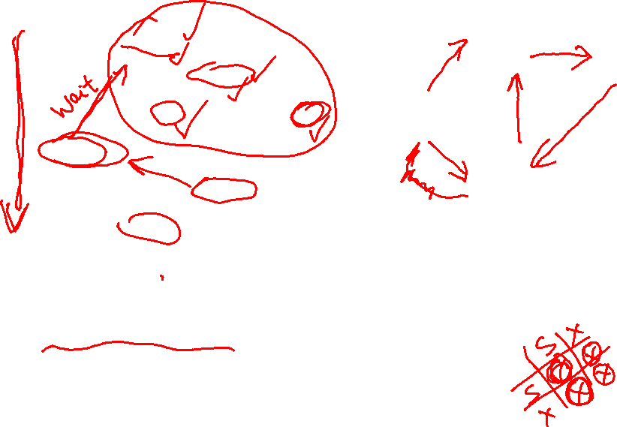
Deadlock Detention – Wait-for Graph
No cycle – so no deadlock!
T17 is waiting for T 18 and T19
T19 is waiting for T18
T18 is waiting for T20
Suppose now T20 is requesting an item held by T19

Slide 50
Deadlock Detection (continued)
Wait-for graph without a cycle
Wait-for graph with a cycle

Slide 51
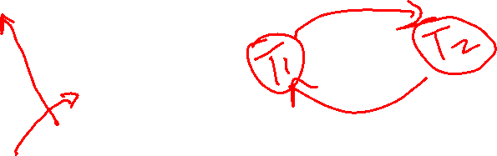
Classroom Exercise 3
Draw the wait-for graph for this schedule

Slide 52
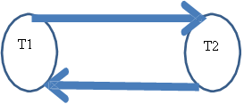
Classroom Exercise 3 - Answer
Draw the wait-for graph for this schedule

Slide 53
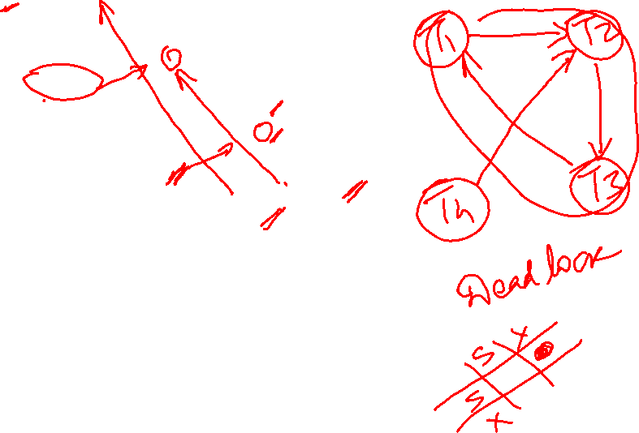
Classroom Exercise 4
T1 | T2 | T3 | T4
Lock-S(A)
Lock-S(D)
 | Lock-X(B)
Lock-S(B)
 |  | Lock-S(D)
 |  | Lock-S(C)
 | Lock-X(C)
 |  |  | Lock-X(B)
 |  | Lock-X(A)
Draw the wait-for graph for this schedule

Slide 54
Deadlock Recovery
When deadlock is detected :
Some transaction will have to be rolled back (made a victim) to break deadlock. Select that transaction as victim that will incur minimum cost.
Rollback -- determine how far to roll back transaction
Total rollback: Abort the transaction and then restart it.
More effective to roll back transaction only as far as necessary to break deadlock (Checkpoint)
Starvation happens if same transaction is always chosen as victim. Include the number of rollbacks in the cost factor to avoid starvation

Slide 55
When to use the different deadlock handling techniques?
Possibility of deadlock:
Low ➔ Deadlock detection & recovery
High ➔ Deadlock prevention

Slide 56

Reading and Assignment
No. | Date | Topics and Required Reading | Assignments
 |  |  |  | start of class day

